Slide 1

LOGISTIC REGRESSION
Presented By:
Amit Verma 100329477
Sparsh Sharma 100329093
Simardeep Kaur 100329207

Slide 2
US ADULT DATASET
Dataset was extracted by Barry Barry Becker from the 1994 US Census Database.
The data set consists of anonymous information such as occupation, age, native country, race, capital gain, capital loss, education, work class and more.
This data was extracted from the census bureau database found at https://archive.ics.uci.edu/ml/machine-learning-databases/adult/
Number of observations: 32560
Number of variables: 14

Slide 3
Variables in Dataset
Age
Workclass
Fnlwgt
Education
Education-number
Marital-status
Occupation
Relationship
Race
Sex
Capital-gain
Capital-loss
Hours-per-week
Native-country

Slide 4
Project Objective
To determine whether an individual earns more than 50K annually or not based on 14 variables such as occupation, age, gender etc.
In order to find the significant variables that affects the response variable most, we have applied following tests:
2-sample t-test
Chi-square test of independence
Hosmer-Lemeshow test
Likelihood Ratio test
Forward Elimination
Backward Elimination

Slide 5
2 Sample t-test (Quantitative Variable)
Step 1: Hypothesis:
Ho : Age is insignificant for prediction of income.
Ha : Age is significant for prediction of income.
Step 2: Perform variance test
The p-value is 2.2e-16 which is less than α(0.05). In conclusion, there is significant difference between the two variances.
Step 3: Perform t-test
The p-value of the test is 2.2e-16 which is less than α(0.05). We can then reject null hypothesis and conclude that age is
significant variable in predicting the income.
data: adult_data$Age[adult_data$Income == " >50K"] and adult_data$Age[adult_data$Income == " <=50K"]
F = 0.58173, num df = 7507, denom df = 22653, p-value < 2.2e-16
alternative hypothesis: true ratio of variances is not equal to 1
95 percent confidence interval:
0.5607432 0.6037101
sample estimates:
ratio of variances
0.5817293
Welch Two Sample t-test
data: adult_data$Age[adult_data$Income == " >50K"] and adult_data$Age[adult_data$Income == " <=50K"]
t = 49.505, df = 16701, p-value < 2.2e-16
alternative hypothesis: true difference in means is not equal to 0
95 percent confidence interval:
7.05999 7.64211
sample estimates:
mean of x mean of y
43.95911 36.60806

Slide 6
Chi-Square test (Categorical Variable)
Step 1: Hypothesis:
Ho : Income is independent of Marital Status
Ha : Income is dependent on Marital Status
Step 2: Perform Chi-Square test
Since p-value is 2.2e-16 which is less than α(0.05). So, we can reject null hypothesis and conclude that Income is dependent on Marital Status.
Single Married
<=50K 14638 8016
>50K 1068 6440
> chisq.test(tbl_MaritalStatus)
Pearson's Chi-squared test with Yates' continuity correction
data: tbl_MaritalStatus
X-squared = 5735.4, df = 1, p-value < 2.2e-16

Slide 7
Tree Algorithm
Tree algorithm identifies the most significant variables by ranking them in decreasing order
Education Number
Capital Gain
Relation-ship
Marital Status
Occup-ation Status
Education level
Capital Loss
Age
Hours per week
Work class
fnlgwt
Race
Sex
Region

Slide 8
Selecting final variables
1. Education Number: This variable is rejected due to its redundency, as it represents the column “education_level” in numeric form.
2. Relationship: This variable represents almost same information as given in “Marital_status”. So, we rejected this variable.
3. Education Level: Occupation status is described by the level of education. So, occupation status is retained and education level is removed.
So, the selected variables are Capital Gain, Capital Loss, Occupation Status and Marital Status.

Slide 9
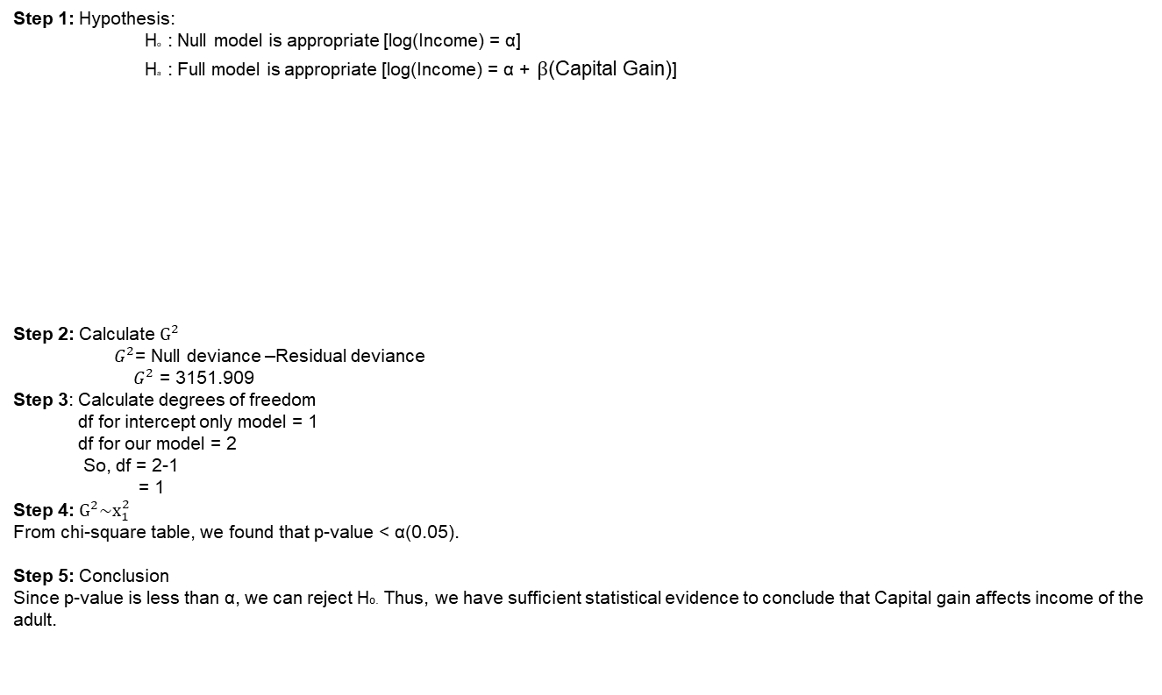
Likelihood Ratio test (Significant variable)
Step 1: Hypothesis:
Ho : Null model is appropriate [log(Income) = α]
Ha : Full model is appropriate [log(Income) = α + $β$(Capital Gain)]
Step 2: Calculate $G^{2}$
$G^{2}$= Null deviance –Residual deviance
$G^{2}$ = 3151.909
Step 3: Calculate degrees of freedom
df for intercept only model = 1
df for our model = 2
So, df = 2-1
= 1
Step 4: $G^{2}\sim x_{1}^{2}$
From chi-square table, we found that p-value < α(0.05).
Step 5: Conclusion
Since p-value is less than α, we can reject Ho. Thus, we have sufficient statistical evidence to conclude that Capital gain affects income of the adult.
Analysis of Deviance Table
Model 1: Income ~ 1
Model 2: Income ~ Capital.Gain
Resid. Df Resid. Dev Df Deviance Pr(>Chi)
1 30161 33851
2 30160 30699 1 3151.9 < 2.2e-16 ***
---
Signif. codes: 0 ‘***’ 0.001 ‘**’ 0.01 ‘*’ 0.05 ‘.’ 0.1 ‘ ’ 1
> null_model$deviance-full_model$deviance
[1] 3151.909
> #Calculating df
> null_model$df.residual-full_model$df.residual
[1] 1

Slide 10
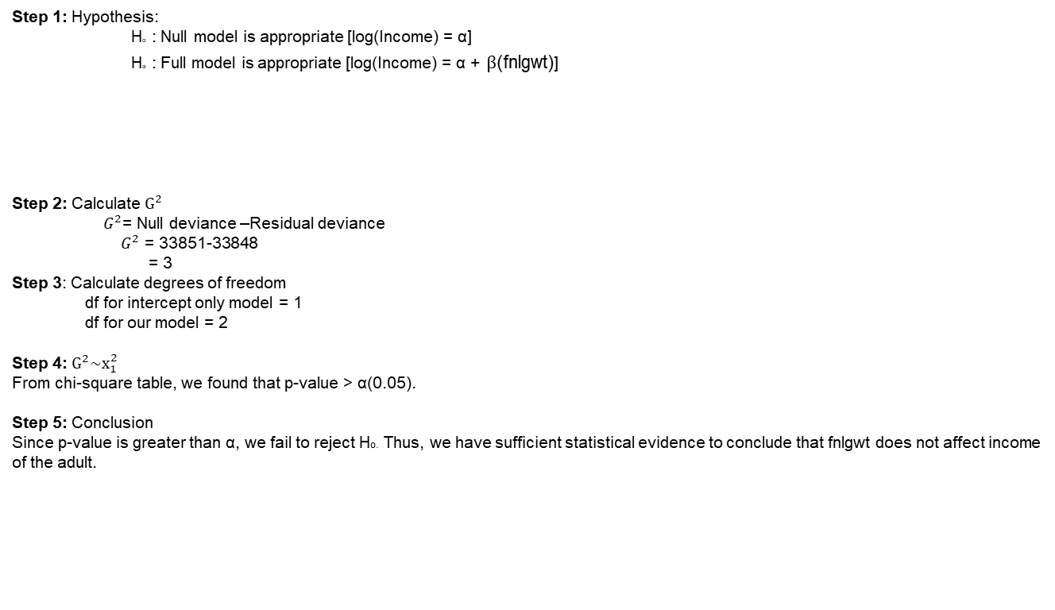
Likelihood Ratio test (Insignificant variable)
Step 1: Hypothesis:
Ho : Null model is appropriate [log(Income) = α]
Ha : Full model is appropriate [log(Income) = α + $β$(fnlgwt)]
Step 2: Calculate $G^{2}$
$G^{2}$= Null deviance –Residual deviance
$G^{2}$ = 33851-33848
= 3
Step 3: Calculate degrees of freedom
df for intercept only model = 1
df for our model = 2
Step 4: $G^{2}\sim x_{1}^{2}$
From chi-square table, we found that p-value > α(0.05).
Step 5: Conclusion
Since p-value is greater than α, we fail to reject Ho. Thus, we have sufficient statistical evidence to conclude that fnlgwt does not affect income of the adult.
Model 1: Income ~ 1
Model 2: Income ~ fnlgwt
Resid. Df Resid. Dev Df Deviance Pr(>Chi)
1 30161 33851
2 30160 33848 1 2.4326 0.1188

Slide 11
Multicollinearity
Multicollinearity takes place when an explanatory variable is highly correlated with one or more explanatory variables;
VIF test for categorical variables.
As, GVIF for both occupation status and marital status are less than 3.16 which means that there is no multicollinearity between these two variables.
VIF test for quantitative variables
Here, VIF for capital gain and capital loss is less than 10, which states that there is no multicollinearity between them.
GVIF Df GVIF^(1/(2*Df))
occupation_status 1.043744 3 1.007161
Marital_Status 1.043744 1 1.021638
Capital.Gain Capital.Loss
1.005459 1.005459

Slide 12
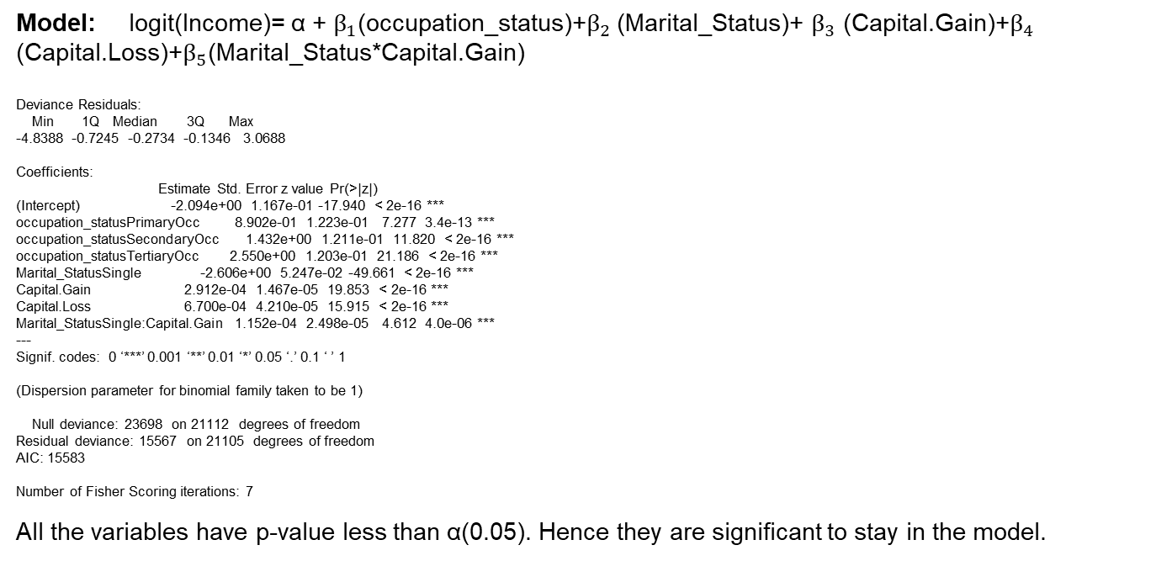
Logistic Regression (Interaction Model)
Model: logit(Income)= α + $β_{1}$(occupation_status)+$β_{2}$ (Marital_Status)+ $β_{3}$ (Capital.Gain)+$β_{4}$ (Capital.Loss)+$β_{5}$(Marital_Status*Capital.Gain)
Deviance Residuals:
Min 1Q Median 3Q Max
-4.8388 -0.7245 -0.2734 -0.1346 3.0688
Coefficients:
Estimate Std. Error z value Pr(>|z|)
(Intercept) -2.094e+00 1.167e-01 -17.940 < 2e-16 ***
occupation_statusPrimaryOcc 8.902e-01 1.223e-01 7.277 3.4e-13 ***
occupation_statusSecondaryOcc 1.432e+00 1.211e-01 11.820 < 2e-16 ***
occupation_statusTertiaryOcc 2.550e+00 1.203e-01 21.186 < 2e-16 ***
Marital_StatusSingle -2.606e+00 5.247e-02 -49.661 < 2e-16 ***
Capital.Gain 2.912e-04 1.467e-05 19.853 < 2e-16 ***
Capital.Loss 6.700e-04 4.210e-05 15.915 < 2e-16 ***
Marital_StatusSingle:Capital.Gain 1.152e-04 2.498e-05 4.612 4.0e-06 ***
---
Signif. codes: 0 ‘***’ 0.001 ‘**’ 0.01 ‘*’ 0.05 ‘.’ 0.1 ‘ ’ 1
(Dispersion parameter for binomial family taken to be 1)
Null deviance: 23698 on 21112 degrees of freedom
Residual deviance: 15567 on 21105 degrees of freedom
AIC: 15583
Number of Fisher Scoring iterations: 7
All the variables have p-value less than α(0.05). Hence they are significant to stay in the model.

Slide 13
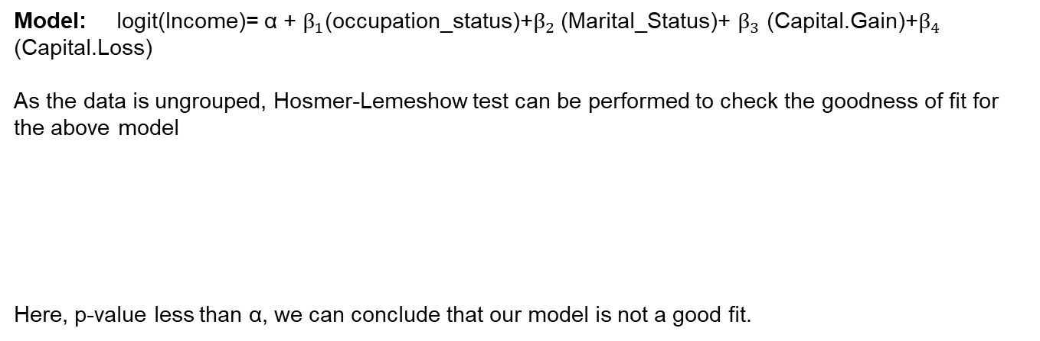
Hosmer-Lemeshow Test
Model: logit(Income)= α + $β_{1}$(occupation_status)+$β_{2}$ (Marital_Status)+ $β_{3}$ (Capital.Gain)+$β_{4}$ (Capital.Loss)
As the data is ungrouped, Hosmer-Lemeshow test can be performed to check the goodness of fit for the above model
Here, p-value less than α, we can conclude that our model is not a good fit.
Hosmer and Lemeshow test (binary model)
data: adult_train$Income, fitted(hosmer_fit)
X-squared = 43.334, df = 7, p-value = 2.875e-07

Slide 14
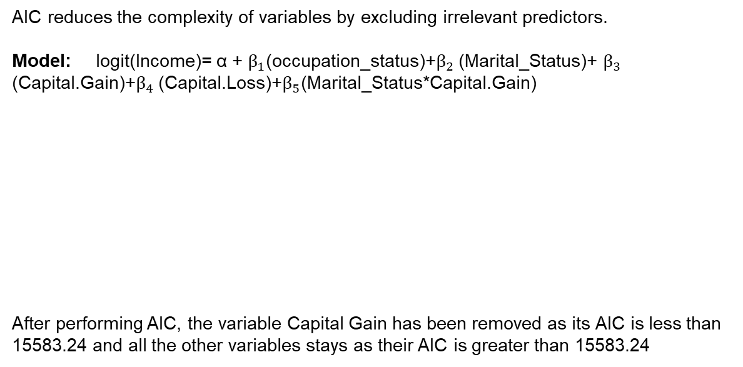
AIC for Interaction Model
AIC reduces the complexity of variables by excluding irrelevant predictors.
Model: logit(Income)= α + $β_{1}$(occupation_status)+$β_{2}$ (Marital_Status)+ $β_{3}$ (Capital.Gain)+$β_{4}$ (Capital.Loss)+$β_{5}$(Marital_Status*Capital.Gain)
After performing AIC, the variable Capital Gain has been removed as its AIC is less than 15583.24 and all the other variables stays as their AIC is greater than 15583.24
Start: AIC=15583.24
Income ~ occupation_status + Marital_Status + Capital.Gain +
Capital.Loss + +Marital_Status:Capital.Gain
Df Deviance AIC
<none> 15567 15583
- Marital_Status:Capital.Gain 1 15589 15603
- Capital.Loss 1 15826 15840
- occupation_status 3 17084 17094

Slide 15
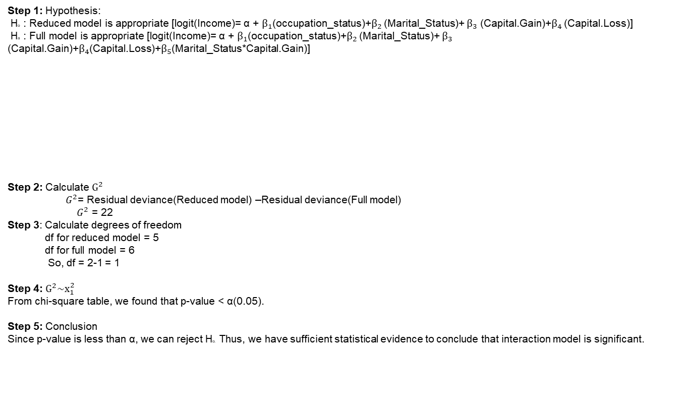
Likelihood Ratio Test (Interaction vs Non-Interaction model)
Step 1: Hypothesis:
Ho : Reduced model is appropriate [logit(Income)= α + $β_{1}$(occupation_status)+$β_{2}$ (Marital_Status)+ $β_{3}$ (Capital.Gain)+$β_{4}$ (Capital.Loss)]
Ha : Full model is appropriate [logit(Income)= α + $β_{1}$(occupation_status)+$β_{2}$ (Marital_Status)+ $β_{3}$ (Capital.Gain)+$β_{4}$(Capital.Loss)+$β_{5}$(Marital_Status*Capital.Gain)]
Step 2: Calculate $G^{2}$
$G^{2}$= Residual deviance(Reduced model) –Residual deviance(Full model)
$G^{2}$ = 22
Step 3: Calculate degrees of freedom
df for reduced model = 5
df for full model = 6
So, df = 2-1 = 1
Step 4: $G^{2}\sim x_{1}^{2}$
From chi-square table, we found that p-value < α(0.05).
Step 5: Conclusion
Since p-value is less than α, we can reject Ho. Thus, we have sufficient statistical evidence to conclude that interaction model is significant.
Analysis of Deviance Table
Model 1: Income ~ occupation_status + Marital_Status + Capital.Gain +
Capital.Loss
Model 2: Income ~ occupation_status + Marital_Status + Capital.Gain +
Capital.Loss +Marital_Status:Capital.Gain
Resid. Df Resid. Dev Df Deviance Pr(>Chi)
1 21106 15589
2 21105 15567 1 22.095 2.595e-06 ***

Slide 16
Final Model (Using R)
Logit (Income)= (-2.094) +(0.8902)*occupation_statusPrimaryOcc+
(1.432)*occupation_statusSecondaryOcc+
(2.55)* occupation_statusTertiaryOcc+
(-2.606)* Marital_StatusSingle + (0.0002912)* Capital.Gain+
(0.00067)* Capital.Loss+
(0.000152)* Marital_StatusSingle*Capital.Gain

Slide 17
Classification Table(R model)
To compare the predicted number of successes to the actual number of successes and predicted number of failures to the actual number of failures.
predicted_r
adult_test$income_test 0 1
0 5468 1380
1 504 1697
Observation:
Based on the output the overall misclassification rate for the model is
1884/9049=.208
For actual income <=50K
Misclassification rate 1380/6848=.201
For actual income >=50K
Misclassification rate 504/2201=.2289

Slide 18
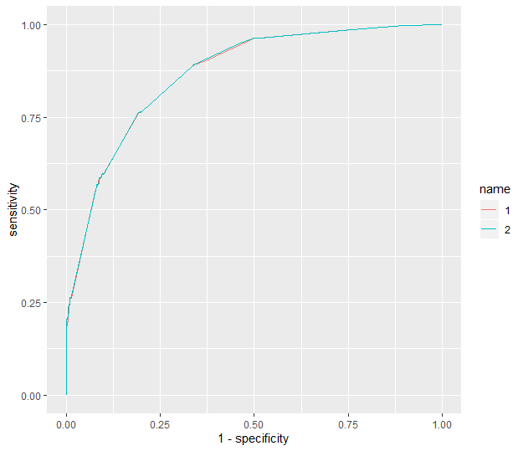
ROC Curve(R model)
ROC Curve is used to determine the sensitivity and specificity of the predictions for all possible cut off π_{o} values.
auc(rocplot)
Area under the curve: 0.8669
Observation:
From the above output, we can see that the ROC Curve of our model is high and area under the curve is 0.8669 which is greater than 0.5. So, we conclude that the final model is the best fit having high curve and more area under the curve.

Slide 19
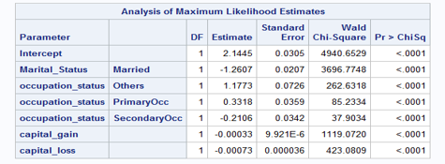
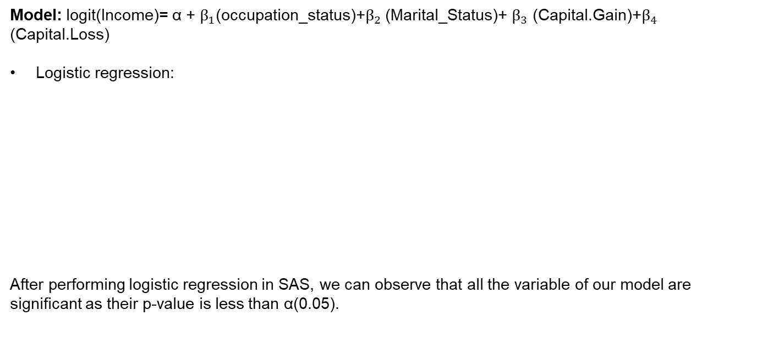
SAS Analysis
Model: logit(Income)= α + $β_{1}$(occupation_status)+$β_{2}$ (Marital_Status)+ $β_{3}$ (Capital.Gain)+$β_{4}$ (Capital.Loss)
Logistic regression:
After performing logistic regression in SAS, we can observe that all the variable of our model are significant as their p-value is less than α(0.05).

Slide 20
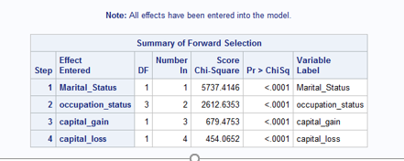
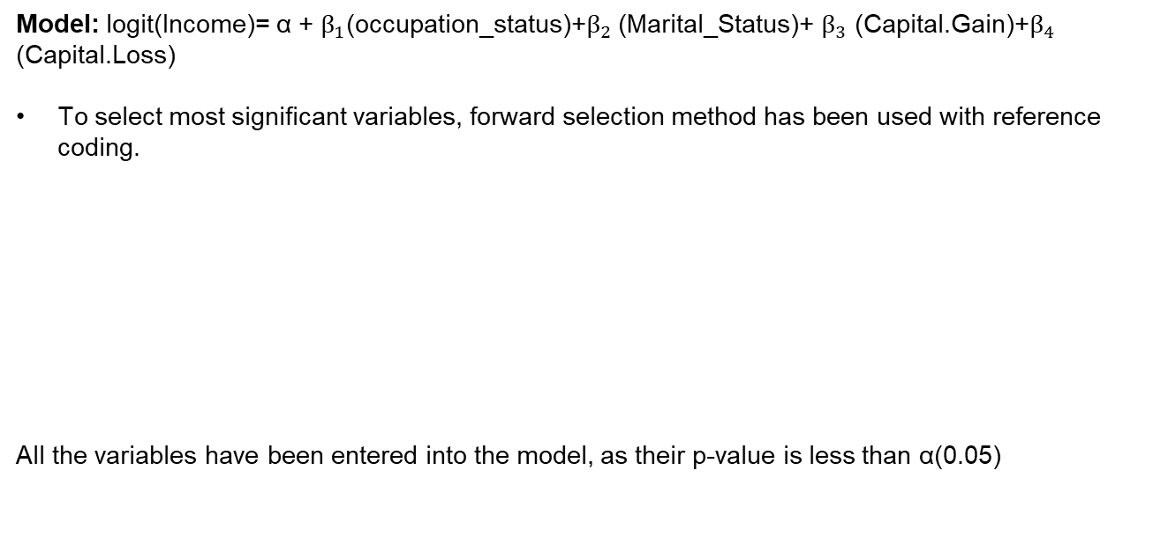
Forward Selection(Non-Interaction model)
Model: logit(Income)= α + $β_{1}$(occupation_status)+$β_{2}$ (Marital_Status)+ $β_{3}$ (Capital.Gain)+$β_{4}$ (Capital.Loss)
To select most significant variables, forward selection method has been used with reference coding.
All the variables have been entered into the model, as their p-value is less than α(0.05)

Slide 21
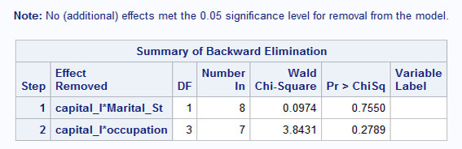
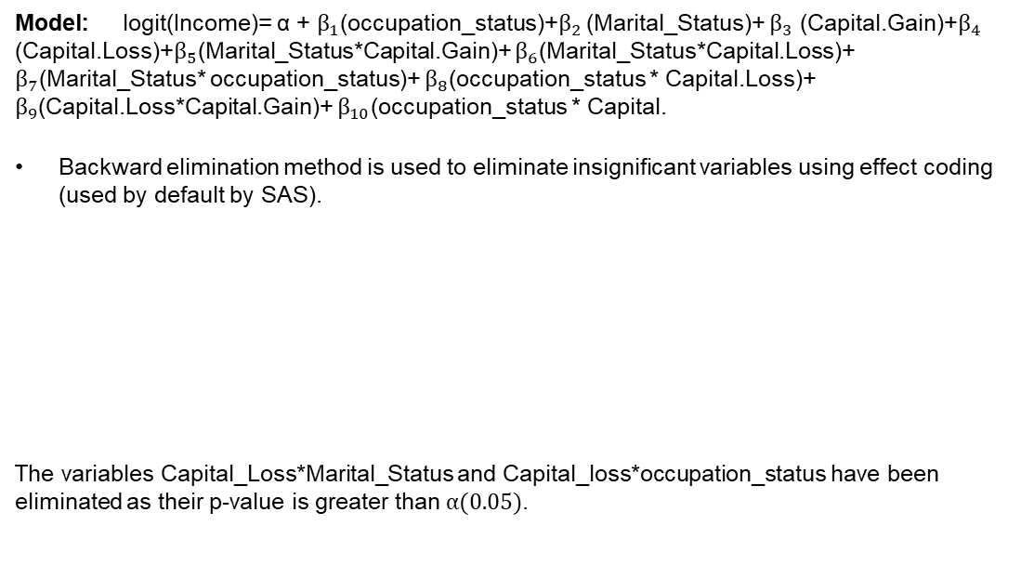
Backward Elimination (Interaction Model)
Model: logit(Income)= α + $β_{1}$(occupation_status)+$β_{2}$ (Marital_Status)+ $β_{3}$ (Capital.Gain)+$β_{4}$ (Capital.Loss)+$β_{5}$(Marital_Status*Capital.Gain)+ $β_{6}$(Marital_Status*Capital.Loss)+ $β_{7}$(Marital_Status* occupation_status)+ $β_{8}$(occupation_status * Capital.Loss)+ $β_{9}$(Capital.Loss*Capital.Gain)+ $β_{10}$(occupation_status * Capital.
Backward elimination method is used to eliminate insignificant variables using effect coding (used by default by SAS).
The variables Capital_Loss*Marital_Status and Capital_loss*occupation_status have been eliminated as their p-value is greater than $α(0.05)$.

Slide 22
Final Model (Using SAS)
Logit(Income) = 2.1751 + (-1.3163) * Marital_Status + 1.1987 * occupation_status(Others) +0.2630 * occupation_status(PrimaryOcc) + (-0.0926) * occupation_status(SecondaryOcc) + (-0.0473) *Marital_Status * occupation_status(Others) + 0.1078 * Marital_Status * occupation_status(PrimaryOcc) + (-0.1826) * Marital_Status * occupation_status(SecondaryOcc) + (-0.00035) * capital_gain + 0.000066 * capital_gain * Marital_Status + (-0.00001) * capital_gain * occupation(Others) + (-0.00003) * capital_gain * occupation (PrimaryOcc) + (-0.00002) * capital_gain * occupation(SecondaryOcc) + (-0.00073) * capital_loss

Slide 23
Classification Table(SAS model)
To compare the predicted number of successes to the actual number of successes and predicted number of failures to the actual number of failure
Predicted sas
adult_test$Income 0 1
0 5458 1390
1 504 1697
Observation:
Based on the output the overall misclassification rate for the SAS model is
1894/9049=.209
For actual income <=50K
Misclassification rate 1390/6848=.202
For actual income >=50K
Misclassification rate 504/2201=.2289

Slide 24
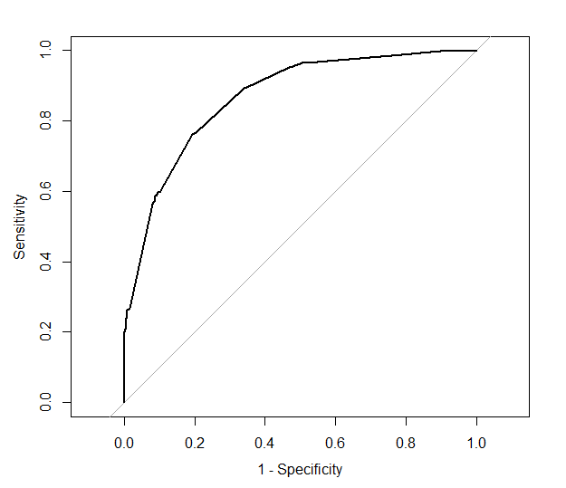
ROC Curve(SAS model)
ROC Curve is used to determine the sensitivity and specificity of the predictions for all possible cut off π_{o} values.
Area under the curve: 0.8674
Observation:
From the above output, we can see that the ROC Curve of our model is high and area under the curve is 0.8674 which is greater than 0.5. So, we conclude that the final model is the best fit having high curve and more area under the curve.

Slide 25
Conclusion
After analyzing the classification tables and ROC Curve for the two models, we select the SAS model to be the best model among the two because area under the curve for SAS model (0.8674) is more than the area under the curve of R model (0.8669). Also, SAS model has higher curve than R model making it the better model. Also, the misclassification rate for R model is 0.208 and for SAS model is 0.209 which also concludes that SAS model is appropriate than R model.

Slide 26
THANKS!

